Slide 1

Proposal for Program Management Consultancy for Business Transformation
BSES Rajdhani Power Limited and BSES Yamuna Power Limited
February 2021

Slide 2
Contents
About Deloitte
Scope of Work
Budgetary Fees
Team Profile
Select Credentials
General Terms and Conditions

Slide 3
About Deloitte

Slide 4

Deloitte is …
Committed to being the best, raising the bar higher and setting the pace for others to follow
Delivers against a broad and deep multidisciplinary portfolio of business capabilities that is distinctive in our profession
Recognised as a leader by independent experts across most capabilities and industries of any professional services provider
Redefining how our professionals serve clients and the public interest by making an impact that matters
REVENUE
US$46.2B
HEADCOUNT
318,200
COUNTRIES AND TERRITORIES
150+
DELOITTE FY2019
OFFICES
725
SOCIETAL IMPACT CONTRIBUTIONS
US$238M+
DELOITTE PROFESSIONALS WHO EXPERIENCED DELOITTE UNIVERSITY
1,32,000+
NEW HIRES
90,540
Deloitte member firms serve 390+ of the Global Fortune 500 companies

Slide 5
Deloitte India
Deloitte India is one of the leading professional services firm with a rich heritage of serving the best in class clients in India
35,000+
India clientele (November 2018 BT500*)
New Delhi
Professionals
spread across
Serves
Serves
Ahmedabad
Jamshedpur
93
115
Vadodara
Kolkata
Consumer and Industrial Products
Energy & resources
of
of
Mumbai
Hyderabad
139
169
Pune
Vijayawada
14
companies
companies
Goa
4
4
Bengaluru
Serves
Serves
Chennai
76
31
Coimbatore
locations
Financial services
of
Life sciences & healthcare
of
Kochi
98
39
companies
companies
4
4
125
Serves
Serves
Deloitte India Services
Audit & Assurance
Tax & Regulatory
Financial Advisory
Risk Advisory
Consulting
44
6
Tech, media & telecom
of
Public sector
of
48
7
Years of successful client service
companies
companies
*BT500 - Business Today publication about India’s top 500 performing companies

Slide 6

Power sector service offerings
Deloitte India has worked across power sector value chain in India on a range of assignments
Service offering
Clientele
 | Strategy & Business Plan | Vision/ Mission Development Development of Corporate Strategy Diversification/ entry strategy Business plans/ including financial projections | Adani, Jindal Power Limited, Tata Power, DVC, PFC, BF-NTPC Energy Systems Ltd, NTPC SAIL Power Company Pvt. Ltd., NTPC, NSETC (World Bank), UHBVN, CSPDCL, JBVNL, BSEB, EESL
 | Transaction Advisory | Bid process management and bid advisory M&A transactions in utility space Distribution Franchisee | Adani, GMR, Tata Power, CESC, L&T, Shyam Indus Power, REC, UJVNL, NTPC, IFC/ Govt. of Gujarat, Sterlite, Ashoka Buildcom, CLP Power, Genus Oriental Structures and others
 | Institutional Strengthening | Handholding/ support in reforms Capacity building Transition management | APTRANSCO/ DFID UK, MPSEB/ GoMP, Uttarakhand Karnataka
 | Restructuring & Reorganization | Financial restructuring Unbundling | YESC and MESC, Myanmar Maharashtra, Bihar, Jharkhand, Chhattisgarh
 | Regulatory Support | ARR and Tariff filings/ reviews Regulations Regulatory studies Utility Audit and Performance Review | CERC, FoR, MERC, HPERC, AERC, BERC, PSPCL, JVVNL, MSPGCL, HPGCL, EDP, CED, BSPCL, NBPDCL, SBPDCL, MSPDCL, TSECL, Indiabulls, Sterlite, Lanco, TPC, Renuka Sugar, Bhaskar Shrachi Alloys, Indian Tea Association, Pioneer Gas etc.
 | Renewable Energy | Studies, project reviews, regulatory etc. Solar, Wind, SHP and other renewable projects | Govt. of Gujarat/ IFC, World Bank, IREDA, JETRO Various private sector players.

Slide 7
Scope of Work

Slide 8
Our Understanding
The PMO Scope Outlay (as per RFP)
Transformation Strategy & Objectives
1
2
3
Development of Strategic Action Plan
Establishment of Monitoring Framework
Implementation Monitoring
Review of strategic roadmap and development of a detailed and actionable work plan
Formulation of process for audit, status review and monitoring of work plan implementation
Data collection and reporting to create measurable impact
4
Risk Review & Mitigation
5
Audit and Validation of Progress
6
Perception Management
Perception Measurement & Reporting

Slide 9
Our Understanding
The PMO Purpose, Mission and Benefits envisaged
Purpose: “To support the needs of senior management for governance decision making and control. To provide direction, alignment, integration and co-ordination to the implementation of the transformation plan for the BRPL and BYPL; ensuring effective tracking, reporting and control.
Mission of the Proposed PMO
Support the Management and the Program Champion in the implementation of the transformation strategy for BRPL and BYPL
Define work-plan and prioritize action items in the best interest of the strategic intent of the transformation; devise measurable KPIs for tracking
Support the co-ordination of scope, objectives, plans, resources, timelines and issues across the programme
Audit performance and achievements reporting
Identify Risk areas of programme, relate these to the anticipated benefits and manage activities to mitigate these risks.
Independent reviewer as management’s eyes and ears during the implementation process
Facilitate the effective flow of information within the programme and between:
Senior management
Points of responsibility
other key stakeholders.
Benefits of a well managed PMO are:
Improved decision making by the programme leadership
Allows projects / work streams to focus on delivery
Improved programme alignment with strategy.
Better understanding of the linkages and dependencies between projects and work streams
Improved communication within and between programme teams.
Improved scheduling of programmes.
Comprehensive and consolidated overview of all activities
Increased awareness of the enterprise initiatives
A single source repository for all key programme information
Consistent approach to programme management
Activity prioritisation based on criticality, dependencies and cost
Uniform decision-making, resource allocation, change control and issue resolution mechanism
Consistency in communication, tracking and reporting

Slide 10
Approach & Methodology
Review of Strategic Action Plan
Review of Strategy Roadmap & Development of Action Plan
Baseline / Milestone identification
Organizational Buy-in
1
Baseline/ Milestones Report
Defining key milestones to define success of engagement
Critical review of Strategy Roadmap (all modules)
Validation of identified interventions
Identification of new interventions
Prioritize initiatives for rollout of the program management framework
Determine Inter-dependence amongst tasks within each work-stream, and inter-dependence across multiple work-streams
Creation of baseline data for performance monitoring & evaluation
Identification of Milestone defining successful execution of strategy
Focus group discussions
Presentation and workshop with key Management personnel and stakeholders for critical review of strategic action plan
Finalization of action plan
Presentation & Workshop to various stakeholders, including Board/ Government
Timelines
T + 1 week
T + 2 weeks
T + 3 weeks

Slide 11
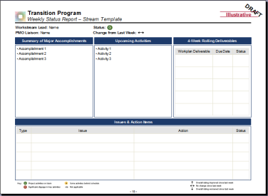
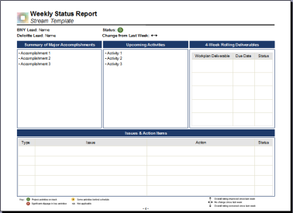
Approach & Methodology
Review of Monitoring Framework
Illustrative Status Reports
Development of report formats and data capturing process maps which can be readily provided to system developers
Creation of summary dashboard for displaying the status against KPIs including major headlines covering activities and issues
Assigning Responsibilities to various business units for furnishing the data, along with timelines, frequency etc.
Alignment of the identified set of data points, to the best extent possible, to the already existing set of reports and reviews at BSES
Identify KPIs on priority, which are/ or can be captured in existing IT Systems/ Tools of the BSES for ease of collection and accuracy
Stream Detail Status Report
Key Deliverables:
Report formats and Reporting Process;
Timeline: At commencement of work

Slide 12
Approach & Methodology
Validation and Review of Progress
Engage in collaborative planning
Identify Key Business Drivers and Objectives
Review BRPL and BYPL’s charter on carrying out this Review exercise
Identify previous Review committee concerns
Determine the Scope of this Review exercise
Design data templates
Present Review Reports to Executive Management
Compile Overall Root Cause Analysis Summary
Track Review Recommendations
1
Co-Develop Expectations
6
Deliver Results and Insights
2
Develop Review Plan
Identify customers / customer categories to gather feedback from and design templates and frameworks to appoint specialized consultants to engage with customers to review the authenticity of claims / inputs by BRPL and BYPL functionaries
Engage with Regulator and Government to gather feedback
Gather feedback from vendors to check on the claims (if any) on timely payment delivery
Review Methodology
Apply Risk Model to assess risk exposure
Prioritize the Review process based on Risk
Develop and Communicate Review Plan
5
Carry out External Review
3
Carry out Field Review
4
Carry out IT Review
Visits to BRPL and BYPL offices for verification of project preparedness, procurement related records, etc.
Field visits to verify investments reported
Field Visits to review actual works undertaken (on sample basis)
Check inadequate validation checks in software detecting cases of non-billing or short/excess billing of meter rent
Check inadequate input controls and lack of proper validation checks resulting in sub-optimal quality of input data
Review perspective
Verify the claims made by BRPL & BYPL functionaries in progress against KPIs identified in the detailed action plan
Appropriateness of measures & reporting systems put in place
Mechanism for action on exceptions generated from measurement systems in place
Coverage:
Monthly Review of select data points through stratified sampling
On case to case basis based on inconsistences observed
On Management request

Slide 13
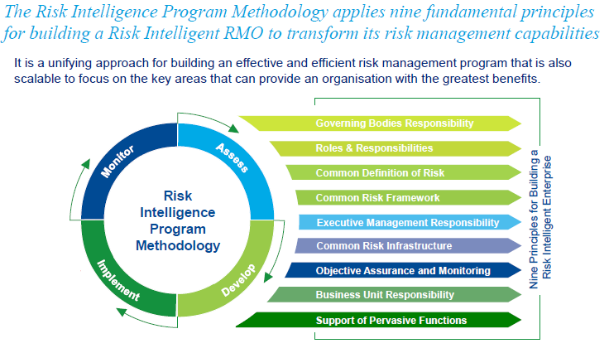
Approach & Methodology
Risk Review and Mitigation
Tools & Methodologies
Objectives
Identify obstacles to achieving objectives - Risks
Assess Risks and prioritize action
Manage exposure
Monitor & learn
Carry out a Risk Assessment and prepare a Mitigation Plan
Key Activities
Risk Assessment and Mitigation Framework
Identify risks pertaining to the strategic initiatives / detailed action plan identified to achieve the business transformation objective
Identify risks coming out from the regular review / monitoring of the actionable items along the key thematic areas identified for carrying out business transformation exercise
Identify the challenges and concerns regarding implementation of strategic initiatives / action plans and key risks around that
Review the currents risks, governance and compliance frameworks of BSES organizations
Identify corporate, regulatory, commercial and technology risks
Identify the governance and regulatory compliance requirements
Prioritize the risks through a structured format of assessing the impact and likelihood of each risk showing the range of risk exposure varying from acceptable, cautionary to unacceptable.
Report the findings to the Management along with proposed risk mitigation strategies / plans for each identified risk item
Key Deliverables
Identification of Risks
Prioritization of Risks showing the range of risk exposure varying from acceptable, cautionary to unacceptable
Risk Mitigation Plan

Slide 14
Work Plan
Key Activities and Timelines
Activity | M1 | M2 | M3 | M4 | M5 | M6 | M7 | M8 | M9 | M10 | M11 | M12
Development of Strategic Action Plan
a) Review of Strategy Roadmap
b) Baseline / Milestone identification creation for identified modules and Action Plan Development
c) Workshops for Organizational Buy-in
Establishment of Monitoring Framework
a) Identification of KPIs
b) Development of detailed framework
c) Rollout and communication
Implementation Monitoring & Reporting
a) Data collection and analysis
b) Reporting and management interaction
Risk Review and Mitigation
a) Risk review reporting and mitigation
Validation and Review of Progress
a) Monthly sample Reviews

Slide 15
Meet the Team

Slide 16
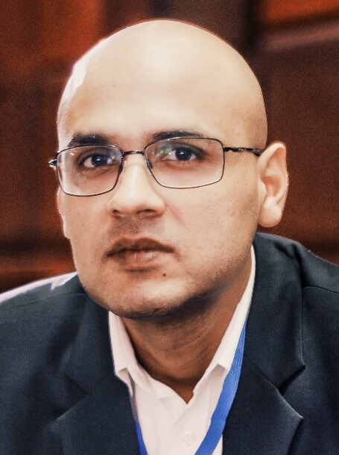
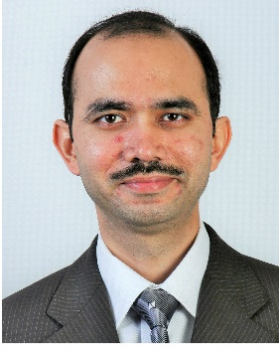

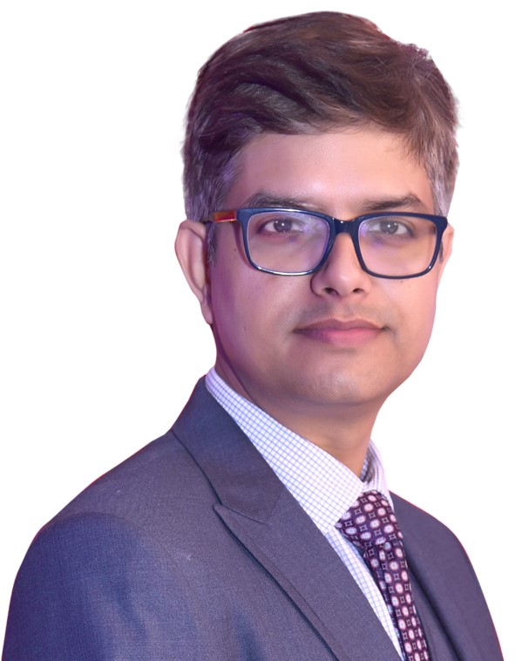
Meet the team
Team Structure
Engagement Leadership
Anujesh Dwivedi
Partner, 17 years experience
BE, PGDM
Shubhranshu Patnaik
Partner, 23 years experience
BE, MBA
Core Team BRPL
Expert Pool
Core Team BYPL
Mohit Bhardwaj
Director, 14 years experience
B.Com (Hons.), MBA (Finance)
Anish Mandal
Director, 18+ years experience
B.Tech, PGDM
Business Strategy Expert
Gaurav Angira
Director, 16 years experience
B.E. (Electronics), MBA
Amit Goenka
Associate Director, 15 years experience
B.Tech, MBA
Pankaj Goinka
Associate Director, 14 years experience
B.Tech, MBA, CFA
Anuj Vashishtha
Director, 16+ years experience
B.Tech, MBA
Power Procurement Expert
Rajat Goel
Manager, 8 years experience
B.Tech, MBA
Kaushikeya Jeta
Manager, 9 years experience
B.Tech, MBA
Satish Kumar Singh
Director, 16+ years experience
B.Tech, MBA
Power System Operations Expert
Somdeb Banerjee
Sr. Consultant, 9 years experience
B.Tech, MBA
Anurag Singh Sirola
Sr. Consultant, 6 years experience
B.Tech, MBA
Shouvik Mukherjee
Consultant, 4 years experience
B.Tech, MBA
P. Hariharan
Director, 25+ years experience
Chartered Accountant
Finance and Accounting Expert
Shehroz Arfeen Khan
Consultant, 7 years experience
B.Tech, MBA

Slide 17
Team Profiles

Slide 18
Meet the Team: Engagement Leadership
Shubhranshu Patnaik
Select Experience:
Renewable Integration and Sustainable Energy Initiative (RISE) under USAID Greening the Grid (GTG) program (Ongoing)
Delhi Electricity distribution System Improvement - Technical, Regulatory and Financial Due Diligence of BSES Rajdhani Power Limited, ADB
Development of Corporate Plan for Power Finance Corporation Ltd. for FY 2013 to FY 2032
Preparation of Corporate Plan for DVC, a vertically integrated utility, for the period 2012-22 with perspective till 2027
Preparation of Digital Strategy for for a leading power sector conglomerate (Ongoing)
Strategy Paper, Standard Business Model for Renewable Energy Projects of NHPC
Preparation of Corporate Plans / Business Strategy for NTPC
(TA 8393-SRI) Preparing the Green Power Development and Energy Efficiency Improvement Investment Programme in Sri Lanka, ADB
Assistance to POSOCO in implementing the National Open Access Registry
Assistance to CERC on re-designing of the day-ahead and intra-day power markets
Assistance to Jindal Power ifor developing a strategy for entry into Distribution Business
Assignments involving transfer of power distribution business in UP, Rajasthan, Maharashtra, West Bengal, Chhattisgarh, etc.
Institutional strengthening support to North Eastern states of Mizoram, Nagaland and Tripura
Financial Due Diligence and Value Analysis for Corporatization of Yangon Electricity Supply Board
Shubhranshu Patnaik
Partner
DID: (91) 124 679 2333
Mobile: (91) 98995 24446
Mail: spatnaik@deloitte.com
Area of Expertise: Emerging Technologies, Power Markets, Reforms, business transformation
Education – MBA (Finance) Xavier Institute of Management, Bhubaneswar, B.E (Electrical)
Key Clients: World Bank, ADB, Odisha Govt., USAID, Shakti Sustainable Energy Foundation (SSEF), DVC, PFC, NTPC, Tata Power, Powerlinks Transmission Company Limited, Essel etc.

Slide 19
Meet the Team: Engagement Leadership
Anujesh Dwivedi
Select Experience:
Review and finalization of Transmission and Distribution investment plans for the state of West Bengal and Andhra Pradesh/ Bihar including Load Flow Analysis, Validation of proposed investments, revision of proposed investments, implementation routes, financing arrangements etc.
Preparation of long term growth strategy in power transmission and distribution business for a leading power sector conglomerate, including review of opportunities in energy storage, electric vehicle charging, solar rooftop installations, smart meters etc.
Assisting Jindal Power for developing a strategy for entry into Distribution Business
Assessment of Business Opportunities in Electricity Distribution Sector in India, WEC India
Advanced Metering Infrastructure and Analytics Guidance Study for South Asian Power Distribution Utilities
Consultancy Support to Distribution Utilities of Haryana (UHBVN & DHBVN) for various operational matters, including review of capital expenditure programs being implemented in the utilities along with their detailed impact assessment
Assisting Ministry of Power, CEA and PFC in preparation of Power for All (PFA) Roadmap for the States of Jharkhand, Assam, Arunachal Pradesh, Maharashtra, Sikkim, Tamil Nadu, Jammu & Kashmir, Andaman & Nicobar, Himachal Pradesh and West Bengal (2015)
Project Management Support to Power Utilities in Rajasthan for capital expenditure schemes of IPDS and DDUGJY
Consultancy services for setting-up a Central Project Monitoring Unit at JBVNL Headquarter for monitoring various projects and programs of JBVNL
Third Party Audit/ Performance Review of PSPCL on several areas including material planning and procurement along with fund management
Anujesh Dwivedi
Partner
DID: (91) 124 679 2754
Mobile: (91) 9811461552
Mail: anudwivedi@deloitte.com
Area of Expertise: Power distribution, smart grids, technology interventions, investment plans plans, business transformation
Education: PGDM (Finance) from Fore School of Management, B.Tech (Electrical)
Key Clients: JBVNL, PSPCL, Adani, Rajasthan Discoms, Haryana Discoms, SIPS, CESU, GMR, Tata Power etc.

Slide 20
Core Team (BRPL)
Team Leader: Mohit Bhardwaj
Select Experience:
Assistance to JBVNL for Diagnostic analysis of Revenue Cycle, Monitoring of MBC of HT consumers and Urja Mitra Program, Continuous Regulatory Assistance in all Regulatory Matters
Setting up Central Strategic Project Monitoring Unit in JBVNL for organizational transformation, Support to top management Commercial, Revenue and Regulatory Related MIS and Strategic Support, Rural Electrification (Central and State funded schemes) – Capital Projects and O&M Schemes, Urban Electrification (Network Strengthening / RAPDRP / IPDS) – Capital Projects and O&M Schemes
Capacity Building Support to JSEB/ its successor entities, undertaking AS-IS reviews and benchmarking across various Operational, Commercial, Finance, Human Resources, Procurement, Regulatory and Governance related matters and developing a Capacity Building & Institutional Strengthening (CBIS) plan for the restructured utilities
Work Study for Bureau of Energy Efficiency (BEE), Organizational structure, the roles and responsibilities of the key employees, forecast the manpower requirements for BEE in accordance with the overall objectives of the organization
Preparation of a report on the power sector for 10 States in India and proposed plans for meeting the objective of 24X7 Power for All
Consultancy support to JBVNL for providing consultancy services for Program Management Support for PFA, UDAY and similar schemes of Central and State Government under JBVNL,
Advisory Services to Haryana Power Generation Corporation Limited (HPGCL) – Haryana Govt. Undertaking (3250MW) related to Fuel Management, Performance Management and Regulatory Assistance
Mohit Bhardwaj
Director
DID: (91) 124 679 2431
Mobile: (91) 8826008825
Mail: mohitb@Deloitte.com
Area of Expertise: Business strategy, program management, corporate structuring, framework development, monitoring and evaluation, institutional strengthening
Education: MBA (Fin), B.com (Hons)
Key Clients: JBVNL, BEE, MoP, HVPNL, HPGCL, HPERC, WBPDCL, PFCCL, IFC, Lanco, World Bank

Slide 21
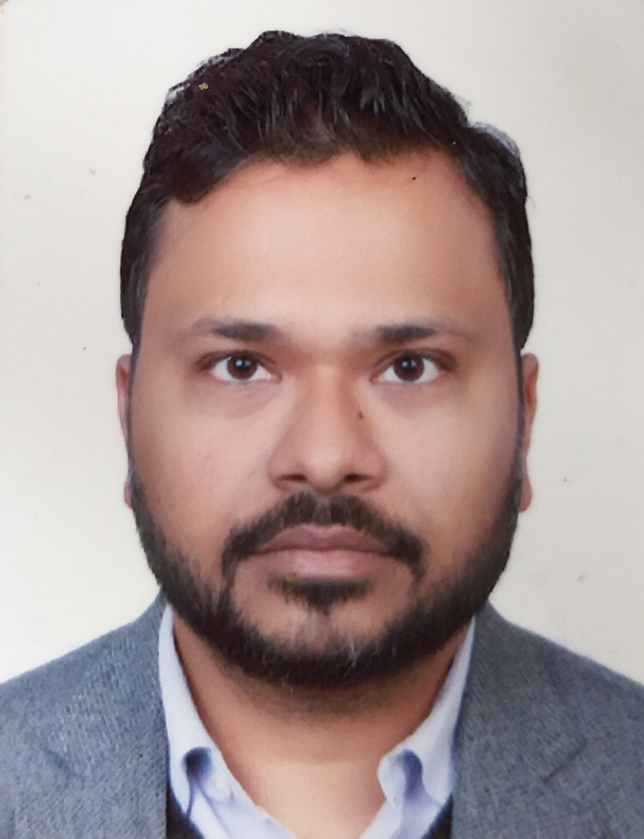
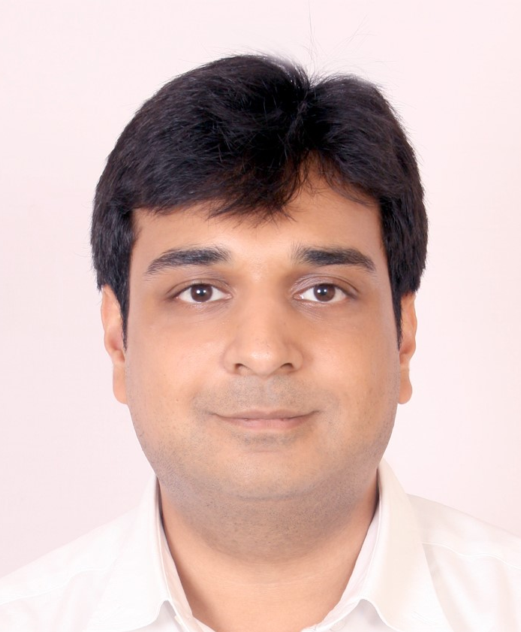
Core Team (BRPL)
Amit Goenka
Rajat Goel
Area of Expertise: Regulatory Economics, ARR and Tariff filing/order, Policy and Regulation
Education: B.com, MBA (Finance)
Key Clients: OERC, HPERC, UPCL, FOR, UPCL, JERC, PTCUL, CSERC, WBPDCL, AERC, ABITA, AVVNL, JdVVNL, JVVNL, RECTPCL, UPPCL
Area of Expertise: Regulatory Economics, market assessment, research, business analytics
Education: BE, MBA
Key Clients: Adani, GMR, HPERC, FOR, World Bank
Select Experience:
Assistance in framing of Tariff Regulations for Generation Business, Open Access Regulations, Deviation Settlement Mechanism Regulations and Forecasting and Scheduling for Solar and Wind Regulations for the State of Odisha
Assistance in issuance of Business Plan and MYT Order for Generation, Transmission, Distribution and SLDC company, Issuance of APR Orders, Review and Appeal matters, etc.
Preparation of Business Plan and Multi Year Tariff Petition of UPCL for the Control Period FY 2019-20 to FY 2021-22
Review of Open Access in Distribution across ten states in India
Preparation of comments/ suggestions on Draft CERC (Terms and Conditions of Tariff) Regulations, 2019 issued by CERC
Preparation of Tariff Order based on the review of Petition by the Union Territories of Andaman and Nicobar and Lakshadweep
Regulatory Assistance to the HPERC on Tariff Related Matters for the 3rd Control Period from FY 2014-15 to FY 2018-19
Select Experience:
Preparation of Business Plan and Multi Year Tariff Petition for Uttarakhand Jal Vidyut Nigam Limited (UJVNL)
Enhancing Financial Sustainability of the Power Sector in Laos PDR and Developing a Suitable Tariff Regime, World Bank
Nepal Power Sector Financial Analysis and Viability Action Plan, World Bank
Development of Long Term Growth Strategy in power T&D business for a large business conglomerate
Assessment of Business Opportunities in Electricity Distribution Sector in India, WEC India
Benchmarking of T&D utilities in Sri Lanka for Public Utilities Commission of Sri Lanka (PUCSL)
Capital cost review and tariff determination for small hydro power plant, HPERC
Assistance to Power Grid in entering the distribution line business in CESU’s area of supply in Odisha

Slide 22
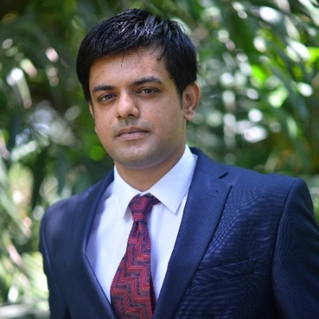

Core Team (BRPL)
Somdeb Banerjee
Shouvik Mukherjee
Area of Expertise: Power procurement, project monitoring, techno-commercial analysis, Project planning
Education: B.Tech, MBA
Key Clients: JBVNL, JUSNL, IOCL, BCPL, BSPGCL,
Area of Expertise:, Market assessment research, sector reforms and policies, business planning
Education: B.Tech (Power Engineering), MBA (Business Management)
Key Clients: JBVNL, GRDICO, PSPCL, NMDC Ltd.,
Select Experience:
Overhauling Procurement process, Project monitoring and preparation of MIS reports, Total project outlay being INR 13,000 crores, Preparation of consolidated guidelines for the Departmental works of JBVNL
Inscribing Operational Excellence by improving IT interfaces, Project Monitoring for Rural and Urban Infrastructure Electrification for JBVNL
Technical analysis of the transmission system, DPR preparation, Financial modelling, Regulatory benchmarking with other systems of similar nature for JUSNL
Creation of L2 and L3 project schedules , Evaluation of Material and Manpower gaps, deputation plan for BSPGCL and IOCL
Preparation of DPR of the works involved in BCPL lepetketa for the SBU of BHEL, Contracting of main packages in the project such as Boiler package, turbine package and auxilliary package
Select Experience:
Central Strategic Project Monitoring Unit in JBVNL for organizational transformation, support to top management, Rural Electrification (Central and State funded schemes) – Capital Projects and O&M Schemes, Urban Electrification (Network Strengthening / RAPDRP / IPDS) – Capital Projects and O&M Schemes;
Preparation of business plan of GRIDCO for FY2020-21 to FY2023-24;
Operations performance review and audit of PSPCL;
Assistance to NMDC in planning, coordination and execution of erection activities for 2*40 MW Gas fired power plant at Jagdalpur in Chattisgarh;
Planning, execution & monitoring of EPC and pre-commissioning activities for 1*18 MW waste heat recovery plant for Wonder Cements Limited, Nimbahera, Rajasthan.
Development of thought leadership reports, market research & analysis of power sector reforms, macroeconomic trends and technology changes in India for a confidential client.

Slide 23
Core Team (BYPL)
Team Leader: Gaurav Angira
Select Experience:
Preparation of Digital Strategy and Execution Roadmap for one of the largest utilities in India having presence in power generation, transmission, distribution, renewable and PV manufacturing
Preparation of Analytics Roadmap for one of the leading private power distribution utility, identified and prioritized analytics use cases with an objective of becoming data driven organization
Development of entry strategy for a large private transmission company into Bangladesh market, assess the market for a transmission business – various risks, opportunities, competition, regulations, returns etc, Created a Public Private Partnership (PPP) model
Designed operating model for Renewable Operating Nerve Centre (RONC) for a Adani Green with a portfolio of more than 5 GW
Reliability improvement of power supply for Andhra Pradesh & Telangana distribution utilities
Project management of two 2X660 MW power plants for a large EPC player, cost and time optimization, Ensure sustainability of solutions through putting up robust governance mechanism
EBITDA Improvement for the Sassan Power (Reliance), Diagnostic of current processes, organization structure, IT systems, people skills etc
Take over assistance and efficiency improvement support to a large private Power Generation company in Nigeria, Financial feasibility assessment, review of contracts, review of operating parameters, MIS and KPIs, energy scheduling, knowledge management, maintenance, inventory & procurement management, revenue management, commercial management, and regulatory management
Gaurav Angira
Director
DID: (91) 124 679 2000
Mobile: (91) 9717003165
Mail: gangira@deloitte.com
Area of Expertise: strategy implementation, data analytics, Project management, process analysis, framework development
Education: MBA (Power Management), B.E. (Electronics)
Key Clients: AP & Telangana Utilities, L&T, Reliance, Adani Green, Sahara Power, GPEL, Sabarmati Gas, Tata Power, DMIC, Welspun

Slide 24
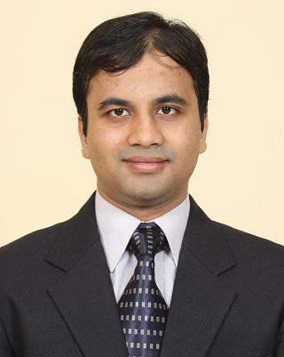
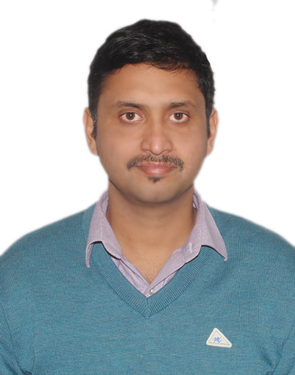
Core Team (BYPL)
Pankaj Goinka
Kaushikeya Jeta
Area of Expertise: Financial Analysis & Modelling, Strategy, business analytics business plans
Education: B.Tech (E&C), MBA (Finance) and CFA (Level III)
Key Clients: Adani, Jindal, World Bank, Torrent Power, CESU, ADB, GMR, Tata Power, PFC, NTPC, DVC
Area of Expertise: Policy reforms and structure, Regulatory expert, ARR Tariff filling/order
Education: B.Tech, MBA
Key Clients: HPGCL, JERC, CSPGCL, MERC, JBVNL, JKPDD, JSEB, PFC
Select Experience:
Assistance to OERC in selection of investor(s) for transfer of ownership and/or management of NESCO power distribution utility;
Assistance to World Bank and MoP in development of new business models for enabling private sector participation in power distribution;
Support to Govt. of UTs on privatization of electricity distribution;
Financial viability analysis and action plan for Nepal Power Sector;
Technical, Regulatory, Commercial and Financial Due Diligence of Delhi Electricity Distribution System;
Preparation of long-term growth strategy in power transmission and distribution business for a leading power sector conglomerate;
Pre-takeover stage strategy development for Jamshedpur Distribution Franchisee for Tata Power Company Ltd.;
Transaction advisory support to CESU for selection of Distribution Franchisee for it’s 14 distribution divisions;
Support to CESU in review of existing and preparation of revised DFA;
Bid Advisory Support to CESC for CESU Power Distribution Utility;
Bid Advisory Support to Tata Power for PESU Distribution Franchisee;
Assistance to SIPS on First Year RPU Analysis for 4 DF areas (AED, CED, SED and NED) under CESU
Select Experience:
Assistance to HPGCL on regulatory matters including filing of tariff petitions and MIS.
Assiting Joint Electricity Regulatory Commission in issuing Tariff Orders for UTs of Chandigarh and Puducherry
Assisting Chhattisgarh State Power Generation Company Limited in filing Petition for final true up for FY 2014-15 and determination of ARR and generation tariff for FY 2016-17 to FY 2020-21
Assisting Maharashtra Electricity Regulatory Commission in issuing Order for R-Infra (Transmission) regarding approval of Mid-Term Review Petition for the Second Control Period from FY 2012-13 to FY 2015-16
Assisting JBVNL in regulatory matters including filing of review petitions, coordinating with JSERC for compliance of directives and other regulatory issues

Slide 25
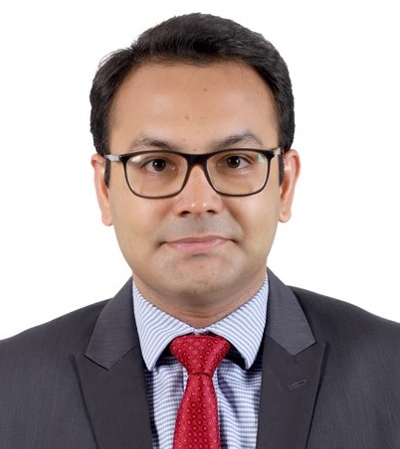
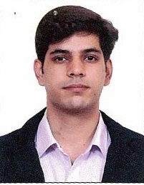
Core Team (BYPL)
Anurag Singh Sirola
Shehroz Arfeen Khan
Area of Expertise: Renewable energy, due diligence, performance review and montioring
Education: B.E. (Electrical), MBA (Power Management)
Key Clients: MSEDCL, JBVNL, HPSEBL, MCC, Godrej & Boyce, Lafarge, Jindal Power, ICICI Bank, SBI.
Area of Expertise: Bid process management, Project Management & monitoring, Power distribution
Education: B.E. (Electrical), MBA (Power Management)
Key Clients: JBVNL, PsVVNL, MPMKVVCL, HPSEBL, SECI, PGCIL, REC, BHEL, PTCUL.
Select Experience:
Continuous assistance to MSEDCL in procurement of Solar (3500 MW) & Wind (750 MW) power on long-term & medium-term basis along with management of regulatory matters (power procurement);
Assistance to JBVNL for diagnostic analysis & monitoring of MBC of LT & HT consumers and support in selection of new billing agencies;
Power Cost optimization through adoption of renewable energy across all units of Godrej & Boyce Mfg. Pvt. Ltd. India;
Transaction Advisory for 3097 MW Etalin Hydro plant in Arunachal Pradesh for Jindal Power Limited;
Support to JREDA in development of Small Hydro Power Projects in Jharkhand;
Management & Operations Performance Audit of ESCOM, Malawi for two consecutive years on behalf of Millennium Challenge Corporation;
Support to ICICI Bank in Project Monitoring and Cash Flow Tracking of Lanco Babandh’s 2x660MW thermal power project in Orissa;
Development of Power & Fuel procurement strategy for Lafarge India;
Comprehensive TEV study of Punj Llyod group on behalf of SBI;
Support to TVNL (2x210MW) in filing its True-up petitions for 2 years;
Select Experience:
Assistance to JBVNL for diagnostic analysis & monitoring of MBC of LT & HT consumers and support in selection of new billing agencies;
Support to JBVNL for implementation of Self-Help Groups for engaging Cluster Level Federation for billing & collection in rural areas;
Support to REC under National Quality Monitoring scheme in monitoring the quality, quantity and progress of 33/11kV rural electrification projects in Uttar Pradesh & Jharkhand;
Planning, procurement & coordination for construction of 33kV, 11kV & LT Lines, 33/11kV substations, BPL Connections under DDUGJY scheme for rural electrification in UP, MP and HP;
Bid Process Management support for a 5-year O&M contract for BHEL’s 10MW Solar power plant in West Bengal;
Preparation of feasibility report for installation of grid connected rooftop solar systems by SECI at government buildings in Delhi;
Planning, procurement, coordination & monitoring of Power Transmission Corporation of Uttarakhand Ltd’s LILO 220 KV D/C Line for Roorkee substation Project.

Slide 26
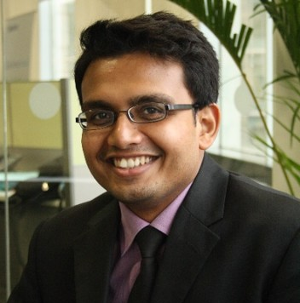
Meet the Team: Expert Pool
Anish Mandal
Select Experience:
USAID/India’s Renewable Integration and Sustainable Energy Initiative (RISE) will assist the Government of India (GoI) to pilot innovative solutions for enhanced transmission grid capacity to support high penetration rates of RE generation
Advising one of the largest Power Generation Company in Indonesia, owning assets across gas, geothermal, mini hydro power plants and O&M services, in rationalizing their complex financial models and develop a new simplified financial model for the purposes of preparing a consolidated business plan, as well as debt financing and capital injection at Holdco and SPV
Advising Electric Power Generation Enterprise (EPGE) and MOEE in development of a least cost power generation plan for near to medium term
Development of a Financial Viability Action Plan for Nepal Power Sector, Financial analysis and Corporate strategy
Development of Corporate Strategy and Business Plan for promoting e-mobility in India
Support the Government of the Republic of the Union of Myanmar (Government) to develop policies, processes and institutional management structures for public-private partnerships (PPP).
Myanmar Power Sector Financial Analysis and Viability Action Plan, Inform stakeholders on the financial status and outlook of the power sector, including revenue requirements and any subsidy requirements for generation, transmission and distribution subsectors
Consultancy support to IFC on corporatization of Yangon City Electricity Supply Board (YESB), Yangon, Financial Due Diligence, Economic Valuation of YESB
Financial and Economic analysis of Upper Indravati Pump Storage Project (PSP) in Odisha
Commercial Feasibility Study of a 650 MW export oriented hydro power project in Lower Arun Valley Area of Nepal, 2013-14
Anish Mandal
Director
Area of Expertise: Financial modeling, corporate strategy, Renewable energy integration, cost optimization
Education: PGDM (Finance), B.tech (Industrial Engg)
Key Clients: JBVNL, BEE, MoP, HVPNL, HPGCL, HPERC, WBPDCL, PFCCL, IFC, Lanco, World Bank

Slide 27
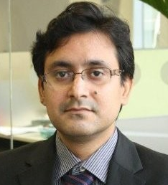
Meet the Team: Expert Pool
Satish Kumar Singh
Select Experience:
Delhi Electricity distribution System Improvement - Technical, Regulatory and Financial Due Diligence of BSES Rajdhani Power Limited, ADB (2014)
Working as the Grants Specialist in Renewable Integration and Sustainable Energy Initiative (RISE) under USAID Greening the Grid (GTG) program (2017-Ongoing)
Impact study of agriculture HVDS scheme implemented Uttar Haryana Bijli Vitran Nigam (UHBVN), Haryana (FY 12-13)
HVDS design for Uttaranchal Power Corporation Limited
Consultancy Support to Distribution Utilities of Haryana (UHBVN & DHBVN) for various operational matters, including review of capital expenditure programs being implemented in the utilities along with their detailed impact assessment
Diagnostic Review & Reform Roadmap Support to Rajasthan Distribution Utilities
Transmission network planning and system study for PTCUL
Review and finalization of Transmission and Distribution investment plans for the state of West Bengal and Andhra Pradesh/ Bihar including Load Flow Analysis, Validation of proposed investments, revision of proposed investments, implementation routes, financing arrangements etc.
Development of network roll-out plan for DPSC under assistance in filing parallel license application in the State of West Bengal
Detailed study of the as-is infrastructure in three north eastern states of India namely Nagaland, Mizoram and Tripura
Cable network study for Hubli city for Karnataka Discom, HESCOM, 2005
Assistance to Tata Power in capex rollout and strategy formulation for franchisee area takeover
Satish Kumar Singh
Director
Area of Expertise: Power distribution network studies and planning, Renewable integration, Technical and commercial due diligence
Education: BE, M.Tech from IIT Roorkee
Key Clients: USAID, POSOCO, BSES Rajdhani Power Limited, PowerGrid, PFC, CESC, Haryana Discoms, JBVNL, Tata Power etc.

Slide 28
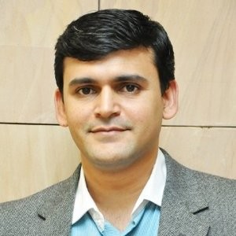
Meet the Team: Expert Pool
Anuj Vashistha
Select Experience:
Assisting MPPPCL and KfW in completing the selection of vendor for Smart Metering as per KfW guidelines and preparation of DPR for SCADA deployment, preliminary design including technical specification, smart metering architecture, PQ and bid documents, SCADA DPR
Transaction Advisory Services to OERC for selection of investor sale of NESCO utility, design transaction structure, preparation of comprehensive information memorandum, Formulation of eligibility and qualification criteria and bid documents
Enabling Private Sector Participation in Electricity Distribution, Stock-taking of existing models in electricity distribution and other infrastructure sectors, Enabling carriage and content separation
Support for innovative contracting frameworks for Smart Metering in India, Study Meter Asset Provider (MAP) and Meter Operations Provider (MoP) contracting framework functional in UK and draw learnings for creating an approach to outsourcing of metering under a service approach
Renewable Integration and Sustainable Energy Initiative (RISE) under USAID Greening the Grid (GTG) program
Feasibility Assessment for Debt Financing of 200MN USD of Underground Cabling, SCADA implementation, Smart Metering and Ring Mains System for Distribution Utilities
Institutional Strengthening of DISCOMs in Rajasthan under 24x7 Power for All (PFA) program
Bid Process Management for advising Ministry of Electric Energy, Govt. of Myanmar in 300 MW rental power project
Development of Solar Mini Grid in Uttar Pradesh on PPP Mode
Development of PPP framework for ESCO based Street Lighting in Odisha and implementation
Anuj Vashistha
Director
Area of Expertise: Smart grid, bid process management, Renewable energy, institutional capacity building, PPP, procurement
Education: BE (Electrical), MBA Power Management
Key Clients: MoP, UPPCL, IFC, World Bank, RGPL, RECTPCL, BSPTCL

Slide 29
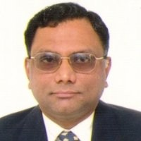
Meet the Team: Expert Pool
Hariharan Pallavoor
Select Experience:
Strengthening of Financial Management System in APSPDCL and in JBVNL;
Strengthening Governance, Financial Management and Capacity Building at HPSEBL (Phase I & II);
Supported Asian Development Bank in preparing outer islands of Maldives for Sustainable Energy Development Projects;
Review of existing accounting issues and design and development of financial accounting manuals of JVVNL, AVVNL and JDVVNL in Rajasthan ;
Transformation of the Accounting Function of Gujarat Electricity Board;
Support to the Electricity Department, Pondicherry in conversion of Government Accounting Statements to Commercial accounting and capacity building of the Accounts Department;
Conversion of Government Accounts to IFRS compliant Accounting Statements for Saudi Railway Organization, Saudi Arabia;
Development of Finance & Accounts Processes, Corporate Plan, Capacity Building for North West Power generation Company Limited, Dhaka, Bangladesh;
Implementation of ERP for financial management, revamping of existing billing system, roadmap for Data Center and Disaster Recovery Site and PMO for implementation at MSEDCL;
Development of Functional Requirement Specifications (FRS) & RFP for implementing an integrated ERP solution for TANTRANSCO;
Support to Transmission Corporation of Andhra Pradesh in Business Process re-alignment to ERP and bid process management for selection of ERP agency;
Support to Dubai Aviation City Corporation in development of policy and process framework under IFRS for Capital Projects Accounting, and Fixed Asset Register Maintenance;
Hariharan Pallavoor
Director
Area of Expertise: Financial Analysis, Finance & Accounting Transformation, Bid Process Management, Business Process Re-engineering
Education: Chartered Accountant (ICAI), B.Com
Key Clients: World Bank, Asian Development Bank, APSPDCL, JBVNL, HPSEBL, TANTRANSCO, JVVNL, AVVNL, JDVVNL,

Slide 30
Budgetary Fees

Slide 31
Commercials
Fees Proposal
1. Timeline and Fees: Our fees are determined based on the level of effort that we would have to spend on this work and the specialty of the experts who would be part of this engagement.
Milestone | Description of Tasks/ Activities Covered | Due Date | Amount - BRPL (INR Lakhs) | Amount - BYPL (INR Lakhs) | Total Amount (INR Lakhs)
Monthly Fees | Monthly Review Reports includes: Implementation Monitoring - Data Collection, Analysis and Reporting Risk review & Mitigation Validation & review | From 1st Month onwards, payable equally at the end of every month (Total Fee for 12 months) | 100 | 100 | 200
Success Fees | Based on percentage success against each milestone, identified for each module – payable on quarterly basis |  | 50 | 50 | 100
Total Fees |  |  | 150 | 150 | 300
2. Tax: Our fee excludes applicable taxes such as GST, which would be charged at rates applicable at the time of invoicing on an actual basis.
3. Out of pocket expenses: Our fee excludes out of pocket expenses for any travel incurred outside of Delhi. All travel will be planned only when approved by Client. Out-of-pocket expenses would be charged as actuals. Out-of-pocket expenses represent travel, outstation stay, communication, document procurement, duplication and delivery and related matters.

Slide 32
Relevant Credentials

Slide 33
Our selected credentials
Related to Project Management Office & strategy implementation
Project Management office for Revenue Improvement and Regulatory filings
Project Management agency for implementation of DDUGJY and IPDS for DISCOMs in Rajasthan
Audit and performance review for Five years (2013-14 to 2016-17) of generation and distribution business
Strategic Central Project Management Unit to Evaluate and Monitor Project Implementation
PMO for Smart Metering implementation in Jaipur City
DPR preparation and PMO for smart metering implementation in Jammu and Srinagar City
Preparation of IT strategy and roadmap for AP DISCOM inc. smart grid
JBVNL
JBVNL
JVVNL
RECPDL
JVVNL, JdVVNL & AVVNL
PSPCL
World Bank
Strengthening of Financial Management including implementation of FM Manual
PMO for Regulatory support for both generation and distribution business
Implementation strategy for Power Procurement cost optimization from CGS
Strengthening of Financial Management including implementation of accounting manual
Institutional strengthening and capacity building of MSPDCL
Institutional strengthening of successor entities of erstwhile JSEB, inc. support for strategy implementation
Institutional strengthening of DISCOMs in Rajasthan
JBVNL
DVC
JBVNL
HPSEBL
MSPDCL
World Bank
World Bank

Slide 34
Our selected credentials
Related to growth strategy and corporate plan
Corporate Strategy Plan for Infrastructure Development Company Limited
Long Term growth strategy for T&D business
Preparation of Corporate Plan 2012-2022 with perspective Plan up to 2027
Designing a Business Plan
Preparation of corporate plan
Digital Transformation Roadmap
Preparation of corporate plan
IDCOL
Leading power sector conglomerate
GEDA
DVC
PFC
Adani
PFCCL
Preparation of Strategy Paper, Standard Business Model for Renewable Energy Projects
Strategy development for JPL’s entry into Distribution and transmission Business
Strategy Formulation of Jamshedpur circle prior to taking over of Tata Power Distribution Franchisee
Assessment of Business Opportunities in Electricity Distribution Sector in India
Preparation of financial model for the power generation and coal mining business
Data Analytics Roadmap
Strategic pathways study
NHPC
Jindal Power
Tata Power
WEC/ NTPC
BYPL
IEX
JSW Energy

Slide 35
Our selected credentials
Related to new and emerging technologies
Advanced Metering Infrastructure and Analytics Guidance Study for South Asian Power Distribution Utilities
Maharashtra Solar Park and Green Grid Development Investment Program
Review of National Solar Mission Phase 1 and strategy for Phase 2
Scaling up rooftop solar in the SME sector in India
Scoping Study of Commercial and Industrial Distributed Generation in Myanmar
Feasibility Study and Bangladesh Pilot for Rural Irrigation with Electric Vehicle
Business Plan for SPV (a proposed JV between EESL, NTPC & PGCIL) to Promote e-Mobility in India
ADB
World Bank
IFC
IFC
World Bank
World Bank
EESL
Renewable Integration and Sustainable Energy (RISE)
Cross Sectoral Synergies and Infrastructure Sharing in Telecom Industry in Myanmar
Roadmap to increase RE footprint through group/ virtual net-metering
Preparation of DPR for li-ion battery manufacturing
Grid Connected Storage -System Evaluation
Future of Urban Mobility: Market Assessment of Electric Vehicles
Develop the State Renewable Energy Plan for five states
USAID
ADB
Indus Towers
Confidential
POSOCO
IFC
Niti Aayog

Slide 36
Our selected credentials
Related to business plan, capex plan and MYT fillings
Preparation of its business plan cum financial turnaround plan
Filing of ARR for FY 2012-13 and support in other regulatory assistance
Regulatory Support for MYT petition for the Control Period FY 2016-17 to FY 2020-21
Regulatory Assistance in filing of ARR and Tariff Petition for FY 13-14
Preparation of Business Plan and filing of MYT petition
Preparation of Business Plan
Filing of ARR and Retail Tariff Petition
TSECL
Chandigarh Electricity Department
JSEB
UHBVN
PSPCL
JBVNL
CSPDCL
Consultancy support to CSEB on Preparation of Business Plan
Business Plan Petition and Multi-Year Tariff Petition for the Control Period FY 2019-20 to FY 2021-22
Diagnostic Review & Reform Roadmap Support to Rajasthan Distribution Utilities
Assistance to WBSEDCL in all regulatory areas
Multi-year Tariff petition for FY 2013-14 to FY 2015-16
Preparation of business plan and MYT fillings
Regulatory Assistance in MYT Filing
UPCL
WBSEDCL
PTCUL
CSEB
Rajasthan Discoms
BSPHCL / erstwhile BSEB
Rinfra-D

Slide 37
General Terms and Conditions

Slide 38
General Business Terms
Definitions
1. Definitions:
“Affiliate” means any entity which is controlling, controlled by, or under common control with the Client;
“Claim" means any claim or proceeding of any nature (whether in contract, tort, breach of statutory duty or otherwise and including, but not limited to, a claim for negligence);
“Client(s)” means the entity (ies) to which the Engagement Letter is addressed and whose name is reproduced above;
"Contract" means the EL and the GBT;
"Deliverable(s)" means any advice, reports, work product or other deliverables identified or described in the EL as agreed to be provided to the Client as a part of the Services;
"DTTL" means Deloitte Touche Tohmatsu Limited, a UK private company limited by guarantee;
"Deloitte Entity" means a member firm of DTTL (including us), but not DTTL itself, and their respective subsidiaries and affiliates, their predecessors, successors and assignees, all partners, associate partners, principals, members, owners, directors, employees, and agents of all such entities. Each Deloitte Entity is a separate and independent legal entity. DTTL does not provide any services to clients and has no responsibility for any Deloitte Entity;
"EL" means the engagement letter entered into between you and we, and any schedules or annexures forming part of it (other than these GBT);
"GBT" means this document titled ‘General Business Terms’;
"Losses" means any losses, Claims, liabilities, damages, costs or expenses in any way relating to or arising out of the Contract or the Services;
"Services" means the services and Deliverables described in the EL;
“Subcontractor” means a third party (other than a Deloitte Entity) to whom we subcontract any of the Services;
“you”, “your” refer to the Client(s);
“we”, “us”, “our”, “DTTILLP” refer to Deloitte Touche Tohmatsu India LLP.

Slide 39
General Business Terms
Contract & Parties
2. About this Contract
This Contract sets out the terms on which we agree to provide Services to you. You and we are acting as principals and neither party may bind the other party to legal obligations unless the other party has agreed to, through a validly executed document, in specific instance(s).
3. Services
3.1 We agree to provide Services in accordance with the Contract. You acknowledge that the scope of the Services is sufficient for your purpose.
3.2 We may subcontract any Services to any other Deloitte Entity or any Subcontractor. Regardless, your contractual relationship is only with us and not with any other Deloitte Entity, Subcontractor or DTTL and we alone (and not any other Deloitte Entity, Subcontractor or DTTL) continue to be responsible and liable to you under the Contract and for the Services. Accordingly, you will not bring any Claim in any way in respect of or in connection with this Contract or the Services against any Deloitte Entity (except us), any Subcontractor or DTTL.
3.3 You may rely only on our final Deliverable. If you wish to rely on drafts or our oral advice, please let us know so we may provide a suitable written final Deliverable on which you may rely. We shall not be responsible if you or others choose to rely on, act or refrain from acting on the basis of any drafts or oral advice.

Slide 40
General Business Terms
Contract & Parties
3.4 Use and Disclosure of Deliverable(s): Notwithstanding anything contained herein, you shall not disclose to any other person the Deliverable(s), or any part of them without our express written consent, except to the extent applicable laws, regulations, rules and professional obligations prohibit limitations on disclosure. You shall use the Deliverable(s) solely for the purposes specified in the EL and, in particular, shall not, without our prior written consent, use the Deliverable(s), or any part of them in connection with business decisions of any other person or for advertisement purposes. You shall not refer to the Services (including Deliverable(s)) or us as provider of the Services in any communication or material provided to any other person. All Services (including Deliverable(s)) are only intended for your benefit. The mere receipt of the Deliverable(s), or any part of them by any other persons is not intended to create any duty of care, professional relationship or any liability between those persons and us. As a consequence, if copies of the Deliverable(s) (or any information derived therefrom) are provided to others under the above exclusion, it is on the basis that we owe no duty of care or liability to them, or any other persons who subsequently receive the same. We accept no liability to any person other than you in connection with the Contract or Services. You agree to pay us for Losses in relation to any claim by any person other than you in relation to the Services.
3.5 Services do not constitute the following: (a) audit, assurance / attest or any review in accordance with the generally accepted auditing or accounting standards or (b) legal advice or services.
3.6 Unless we have specifically agreed to in the EL, we shall not provide advice regarding the financial accounting treatment of any transaction arising from the Services or take responsibility for any financial reporting with respect to the Services.
3.7 In performing the Services, unless otherwise expressly stated in the EL, we will not be deemed to know or required to use information from any other services performed by us whether for you or any other third party, whether such information might be considered material to you or not.

Slide 41
General Business Terms
Your responsibilities
4. Your responsibilities
4.1 To enable us to provide the Services, you agree to cooperate with us and, among other things: (i) provide us with reasonable facilities and timely access to data, information and your personnel; (ii) be responsible for the actions and decisions made by your personnel, representatives and agents, for the accuracy and completeness of all data and information provided by you or on your behalf, and for the implementation of, as you consider appropriate, any advice provided as part of the Services (iii) obtain any applicable consents in respect of our using/processing any confidential/personal information for performing the Services. We may provide our Services relying on the information you make available to us and your decisions and approvals. You acknowledge that our performance shall be dependent upon the timely performance of your responsibilities under the Contract.
4.2 You shall be solely responsible for, among other things: (i) making all management decisions and performing all management functions; (ii) designating one or more individuals who possess suitable skill, knowledge, and/or experience, preferably within senior management to oversee the Services; (iii) evaluating the adequacy and results of the Services; (iv) accepting responsibility for the results of the Services; and (v) establishing and maintaining internal controls, including, without limitation, monitoring ongoing activities.
4.3 Unless the EL specifies other arrangements, you agree that any Deliverables will be deemed accepted by you (and the Services, or the relevant part of them complete) within 10 days of their delivery, upon their delivery in their final form or when you first make use of them in its business, whichever comes first.

Slide 42
General Business Terms
Our responsibilities
5. Our Responsibilities
5.1 This is a services contract. We warrant that we shall perform the Services in good faith and in a professional manner.
5.2 We will endeavour to supply the Services in accordance with any timeline referred to in the EL or otherwise agreed by the parties in writing. However, unless the parties specifically agree otherwise in writing, all dates given by us or specified by you for the Services are intended for planning and estimating purposes only.

Slide 43
General Business Terms
Fees
6. Fees
6.1 You agree to pay us fees for our Services and: (a) all applicable taxes and statutory levies (including Goods and Services Tax); and (b) unless stated otherwise in the EL, our out-of-pocket expenses at actuals (collectively “Charges”). Our invoices are payable upon your receipt. We may apply an interest calculated at the rate of 1% per month for each day our invoice(s) remain(s) unpaid for 1 (one) month or more from your receipt. In addition to any other right, we are not obliged to continue providing the Services where our invoices are overdue.
6.2 At the time of payment of invoices, you may deduct income tax at source at the applicable rates (“TDS”) as necessary to comply with law in India, provided that, you give us documentation and confirmations required under law for those deductions, in a timely manner using our correct details. You and we shall each comply with our respective responsibilities under the applicable tax regime (currently Goods and Services Tax regime) as service provider and service recipient.
6.3 Any estimate of the fees involved in the Services will be based upon our assessment of the work involved, taking account of any assumptions set out in the EL. Unless we have agreed otherwise in the EL, our fees may be adjusted, for example, if the Services prove more complex or time consuming than expected.
6.4 You agree to pay us for any costs that any Deloitte Entity or Subcontractor may incur or bear in complying with any legal, professional, regulatory or other equivalent disclosure requirement relating to any of the Services imposed in any proceedings or regulatory process not involving any substantive claim or proceeding against any such Deloitte Entity or Subcontractor. Where legally and reasonably practicable we will notify you of the disclosure.

Slide 44
General Business Terms
Term and Termination
7. Term and Termination
The Contract comes into effect upon the earlier of commencement of Services or the EL being signed by both parties. Unless terminated sooner in accordance with its terms, the Contract will continue to be in force: (i) if the EL mentions a validity period, during such validity period; or (ii) if the EL does not mention a validity period, until the Services have been performed. Either you or we may terminate this Contract without cause by giving the other party a prior written notice of at least 1 (one) month. If either you or we are in breach of this Contract and do not remedy the breach within 1 (one) month of receiving the other party’s written notice specifying the breach, then the other party may terminate this Contract by giving the party in breach a written notice of 7 days. In addition, we may terminate this Contract by a written notice to you if we determine that a law, regulation or anything having a similar import, or a circumstance (including cases where your ownership or constitution has changed), makes our performance of the Contract impermissible or in conflict with independence or professional rules applicable to us. Upon termination, you agree to pay us for all Services performed up to the effective date of termination.
8. Ownership
On payment of all of our Charges in connection with this Contract, you shall obtain a non-exclusive license to use within your internal business, subject to the other provisions of this Contract, any Deliverable(s) for the purpose for which the Deliverable(s) were supplied. We retain all rights in the Deliverable(s) and work product, and in any software, materials, know-how and/or methodologies that we may use or develop in connection with this Contract.

Slide 45
General Business Terms
Limitation of Liability
9. Limitation of Liability
9.1 Under no circumstance will our aggregate liability for all Losses ever exceed the fees received by us for the Service(s) to which the Losses relate. In circumstances where the Service(s) are for a period exceeding 12 months, the aforementioned limit shall be an amount not exceeding the fees received by us for such Service(s) in the 12-month period preceding to which such Losses relate. For the avoidance of doubt, the foregoing does not seek to limit our liability for fraud or other liability to the extent the law does not permit limitation.
9.2 Where we are liable to you under this Contract and: (a) any other person with whom you have an agreement or with respect to whom you are a beneficiary is also liable to you for the same Losses; or (b) you have contributed to such Losses; then compensation payable by us to you in respect of such Losses will be reduced taking into account the extent of responsibility of each relevant party without taking into account any limit or exclusion placed on the amount payable by such other person or your ability to recover from such other person.
9.3 We will not be liable for Losses arising due to any incorrect, incomplete or misleading information or documentation provided by any person other than a Deloitte Entity or a Subcontractor.
9.4 We will not be liable for any indirect Losses, special, consequential or punitive damages or Losses, including but not limited to, loss of business or data or profits or goodwill.

Slide 46
General Business Terms
Limitation of Liability
9.5 Where the EL is addressed to multiple parties and/or the EL is executed by you expressly for and on behalf of yourself and any other person(s), then (i) the limits on our liability in this clause 9 will apply collectively to and be shared amongst you and all such persons/parties, and it is up to you and those persons/parties how to share it; and (ii) the terms and conditions of this Contract shall be binding on each such person/parties except that none of the other persons/parties will have the right to bring any Claim arising in any way in connection with or relating to the Services or this Contract against us and you alone shall have the right to bring any Claim against us in respect of the Services or this Contract. You represent and warrant that you have the power and authority to (A) execute this Contract and (B) bind yourself and all such parties/person (to the extent that they are not a signatory to the Contract), to the terms and conditions of this Contract.
9.6 Without any other Deloitte Entity or DTTL or Subcontractors being considered a party to this Contract, the liability cap and exclusions operate to their benefit to the extent it is judicially determined that any of them have any liability under or in connection with the Contract or the Services.

Slide 47
General Business Terms
Confidentiality
10. Confidentiality
10.1 We and you each agree to keep confidential the other’s information which is either designated in writing as “confidential” or is by its nature manifestly confidential (“confidential information”) and not use it for any purpose other than as necessary for availing or provision of the Services. We may disclose your confidential information: (a) to any Deloitte Entity or Subcontractors and to contractors providing administrative and infrastructure/support services, that have agreed to be bound by confidentiality obligations similar to those in this clause 10; (b) to our auditors, insurers or in accordance with applicable professional standards, or in connection with potential litigation.
10.2 In the performance of the Services, any Deloitte Entity or any Subcontractor may communicate or discuss the matters relevant to the Services with your other advisors and may do so free from any obligation of confidentiality.
10.3 Confidentiality obligations of this clause 10 do not apply to information which: (a) shall have otherwise become publicly available through no breach of the receiving party of this clause 10, (b) becomes available to the receiving party on a non-confidential basis from a source other than the disclosing party, (c) is known by the receiving party prior to (or independent of) its receipt from the disclosing party without any obligation of confidentiality with respect thereto; (d) is developed by the receiving party independently without reference to the confidential information received. Confidentiality obligation will not apply to the extent any information is required to be disclosed to comply with any order, request or requirement to provide information of a regulatory, judicial, government or other authority or a professional body or legal advisors solely for the purpose of obtaining legal advice. The obligations imposed by this clause 10 shall survive the termination of this Contract for a period of one year.

Slide 48
General Business Terms
Force majeure and third party claims
11. Force Majeure
Neither you nor we shall be liable for any delays or non-performance directly or indirectly resulting from circumstances or causes beyond, your or our reasonable control including without limitation acts of God; any law, order or requirement of any government agency or authority. This does not excuse your obligation to pay us Charges for Services rendered.
12. Third Party Claims
You shall indemnify and hold harmless the Deloitte Entities, Subcontractors and DTTL for all Losses arising in connection with any third party Claim in relation to or pursuant to the Contract or the Services, except to the extent finally judicially determined to have resulted primarily from the fraud of such Deloitte Entities, Subcontractors and DTTL.

Slide 49
General Business Terms
Miscellaneous
13. Miscellaneous
13.1 This Contract is the entire agreement between the parties with respect to the Services and supersedes all prior agreements, proposals, understandings, representations or discussions. The terms of this GBT shall prevail to the extent of a conflict between the GBT and the EL. If we have signed or sign any vendor onboarding documents or data room access terms or purchase order, you acknowledge that those are only to meet your procedural or administrative requirements and they do not increase our scope of work or liability or grant you any more rights than are stated in this Contract. This Contract may only be modified in writing expressly stating the intent of the parties to modify this Contract. If we or you, as the case may be, have not sought to strictly enforce any term of this Contract, it does not operate as a waiver in that or any other instance.
13.2 We are not liable for any representation or warranty that is not expressly set out in this GBT. We will not be liable for any Losses arising out of your use of the Services for any purpose other than as set out in the EL.
13.3 You and we may both be subject to laws prohibiting bribery and corruption as well as internal organizational policies and codes on anti-bribery and corruption. In the performance of this Contract, each party will comply with such applicable laws and their respective codes. In connection with the Services, each of us agree not to offer, promise or give financial or other advantage to another person with the intention of inducing such a person to perform improperly or to reward improper behavior for your benefit, in each case, in violation of the Prevention of Corruption Act, 1988 and any other similar laws to which each of us is subject.
13.4 We and you will each comply with our respective obligations under the applicable data protection laws to the extent in connection with the Contract and the Services either we or you store, process or transfer any personal data to which data protection laws apply (“Personal Data”). We will use any Personal Data provided by you or on your behalf, in relation to the Services in compliance with legally required obligations applicable to us and, where relevant, only in accordance with lawful and reasonable instructions from you. Where Personal Data is not required for performance of the Services, you are encouraged to redact the documents such that Personal Data is not made available to us. You represent that you have the required consents from the data subject for use of the Personal Data in relation to this Contract. Any unwarranted disclosure of Personal data by you shall be your sole responsibility.

Slide 50
General Business Terms
Miscellaneous
13.5 Any clause that by its reasonable implication is intended to survive or be performed post the expiry or termination of this Contract (such as those in relation to the Fees (to the extent unpaid), Limitation of Liability, Indemnity, Use and Disclosure of Deliverables, Governing Law and Jurisdiction), will survive the expiry or termination of this Contract.
13.6 No person who is not a party to this Contract other than a Deloitte Entity and DTTL shall be entitled to enforce any of its terms. This Contract can be varied by the parties without any third party's consent.
13.7 We have no responsibility to monitor events occurring after the date of the Services nor to update any Deliverable.
13.8 Nothing contained herein will prevent or restrict us from providing services to other clients (including services which are the same or similar to the Services).
13.9 No party may assign or otherwise transfer this Contract without the prior express written consent of the other, except that we may assign any of our rights or obligations hereunder to any Deloitte Entity and to any successor of our business.
13.10 If any provision or part of this Contract is found by a court of competent jurisdiction or other competent authority to be unenforceable, illegal or void, it shall not affect the remainder of the Contract, but such unenforceable, illegal or void provision or part shall be deemed modified to the extent necessary to render it enforceable, preserving to the fullest extent permissible the intent of the parties under this Contract.

Slide 51
General Business Terms
Miscellaneous
13.11 The headings in this Contract are for convenience only and shall not affect the interpretation of this Contract.
13.12 Except as instructed otherwise in writing, each of us may assume that the other approves of properly addressed fax, email (including email exchanged via Internet media) and voicemail communication of both sensitive and non-sensitive documents and other communications concerning this Contract, as well as other means of communication used or accepted by the other. It is recognized that the Internet is inherently insecure and that data can become corrupted, communications are not always delivered promptly (or at all) and that other methods of communication may be appropriate. Electronic communications are also prone to contamination by viruses. Each of us will be responsible for protecting our own respective systems and interests and, to the fullest extent permitted by law, will not be responsible to the other on any basis (whether in contract, statute, tort or otherwise) for any loss, damage or omission in any way arising from the use of the Internet or from access by any Deloitte Entity to your networks, applications, electronic data or other systems.
13.13 We may refer to the Services we have performed, to present our experience and credentials along with your name and/or logo for the limited purpose of internal use and/or in the proposals to our existing/prospective clients.
13.14 This Contract, including all matters relating to it, shall be governed by the laws of India without giving effect to the choice of law principles thereof and the parties submit to the exclusive jurisdiction of the courts of law in Mumbai and their appeal courts

Slide 52

Deloitte refers to one or more of Deloitte Touche Tohmatsu Limited, a UK private company limited by guarantee (“DTTL”), its network of member firms, and their related entities. DTTL and each of its member firms are legally separate and independent entities. DTTL (also referred to as “Deloitte Global”) does not provide services to clients. Please see www.deloitte.com/about for a more detailed description of DTTL and its member firms.
This material has been prepared by Deloitte Touche Tohmatsu India LLP (“DTTILLP”), a member of Deloitte Touche Tohmatsu Limited, on a specific request from you and contains proprietary and confidential information. This material may contain information sourced from publicly available information or other third party sources. DTTILLP does not independently verify any such sources and is not responsible for any loss whatsoever caused due to reliance placed on information sourced from such sources. The information contained in this material is intended solely for you. Any disclosure, copying or further distribution of this material or its contents is strictly prohibited.
Nothing in this material creates any contractual relationship between DTTILLP and you. Any mutually binding legal obligationsorrights may only be created between you and DTTILLP upon execution of a legally binding contract. By using this material and any information contained in it, the user accepts this entire notice and terms of use.
©2019 Deloitte Touche Tohmatsu India LLP. Member of Deloitte Touche Tohmatsu Limited
Deloitte Touche Tohmatsu India Private Limited (U74140MH199 5PTC093339), a private company limited by shares, was converted into Deloitte Touche Tohmatsu India LLP, a limited liability partnership (LLP Identification No. AAE-8458),with effect from October 1, 2015.

